Slide 1

AI Course Selection
Project Audit 2

Slide 2

Our Story
We are creating an innovative and user-friendly solution to make course selection quicker and easier for students.
Every semester, tertiary students have to enrol in courses they want to take. They seek out the ANU, its website and third parties for suggestions and reviews of potential courses.
Sometimes this is a logistical nightmare – and it’s impossible to decide on which courses to choose.
This is where AI course selection comes in.

Slide 3
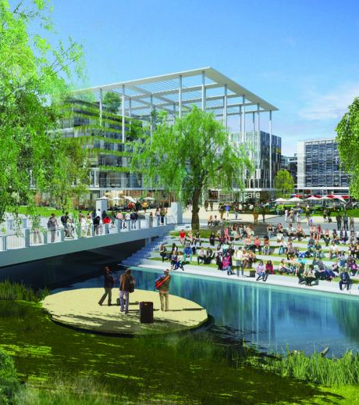
Our Story
We are creating an innovative and user-friendly solution to make course selection quicker and easier for students.
Every semester, tertiary students have to enrol in courses they want to take. They seek out the ANU, its website and third parties for suggestions and reviews of potential courses.
Sometimes this is a logistical nightmare – and it’s impossible to decide on which courses to choose.
This is where AI course selection comes in.

Slide 4
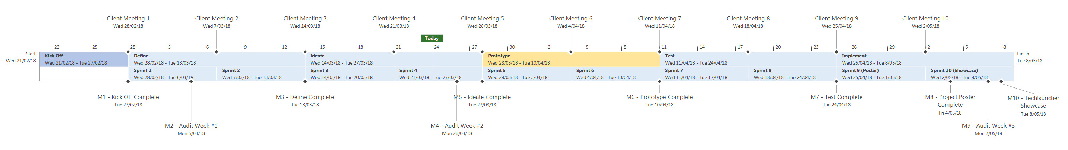
Project Timeline
^
Client Meeting 1
Client Meeting 2
Client Meeting 3
Client Meeting 4
Client Meeting 5
Client Meeting 6
Client Meeting 7
Client Meeting 8
Client Meeting 9
Client Meeting 10
Today
Start Wed 21/02/18
Kick Off
Weeks 1-2
Define
Weeks 2-4
Ideate
Weeks 4-6
Prototype
Lecture Break
Test
Weeks 7-8
Implement
Weeks 8-10
Finish Tue 8/05/18
Sprint 1
Weeks 2-3
Sprint 2
Weeks 3-4
Sprint 3
Weeks 4-5
Sprint 4 Weeks 5-6
Sprint 5
Break week 1
Sprint 6
Break week 2
Sprint 7
Week 7
Sprint 8
Weeks 7-8
Sprint 9 (Poster)
Weeks 8-9
Sprint 10 (Showcase)
Weeks 9-10
M8 - Project Poster Complete
M10 - Techlauncher Showcase Tue 8/05/18
M2 - Audit #1
M4 - Audit #2
M9 - Audit #3
Kick Off
Team introductions
TechLauncher induction workshop
Kick off meetings with clients at Accenture
Define
Prepare and send out survey to ANU students
Interview academic officers for relevant information
Collate and analyse the chatbot, interview, and survey data.
Refine the scope of the problem
Ideate
Brainstorm designs and concepts based on gathered data (Sprint 3)
Create a feature list for the product (Sprint 3)
Conceptualise AI framework (Sprint 4)
Prototype options for recommendations of AI model (Sprint 4)
Try out ideas for AI recommendations and searches (Sprint 4)
Prototype
Create high level design for the finalised product (Sprint 5)
Decide on the tech stack
Complete task chunking for first prototype
Meet to assign responsibilities in prototype creation
Code prototype (Sprint 6)
Code reviews
Deploy imitation chatbot for data collection (Sprint 1)

Slide 5
Data Collection Channels
Poll
Survey
Interview
Imitation Chatbot
Distributed Survey
ANU Facebook
Large sample
Definitive answer to “Website or Chatbot?”
ANU Facebook
31 responses
Useful and clear data
Narrowed project scope
APO at Fenner Hall
Refined survey questions
Agreement with poll and survey results
ANU Facebook
Limited results
Questions for Intelligent Search
Large unbiased sample
Survey approved but not deployed
Recommended action: Ethics approval
✔
✔
✔
✔
✘

Slide 6
Chatbot, Website, or App?
Poll
Survey
Platform: Website

Slide 7
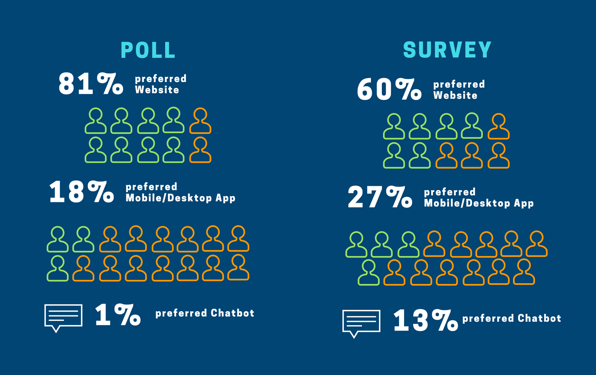
Platform: Website

Slide 8
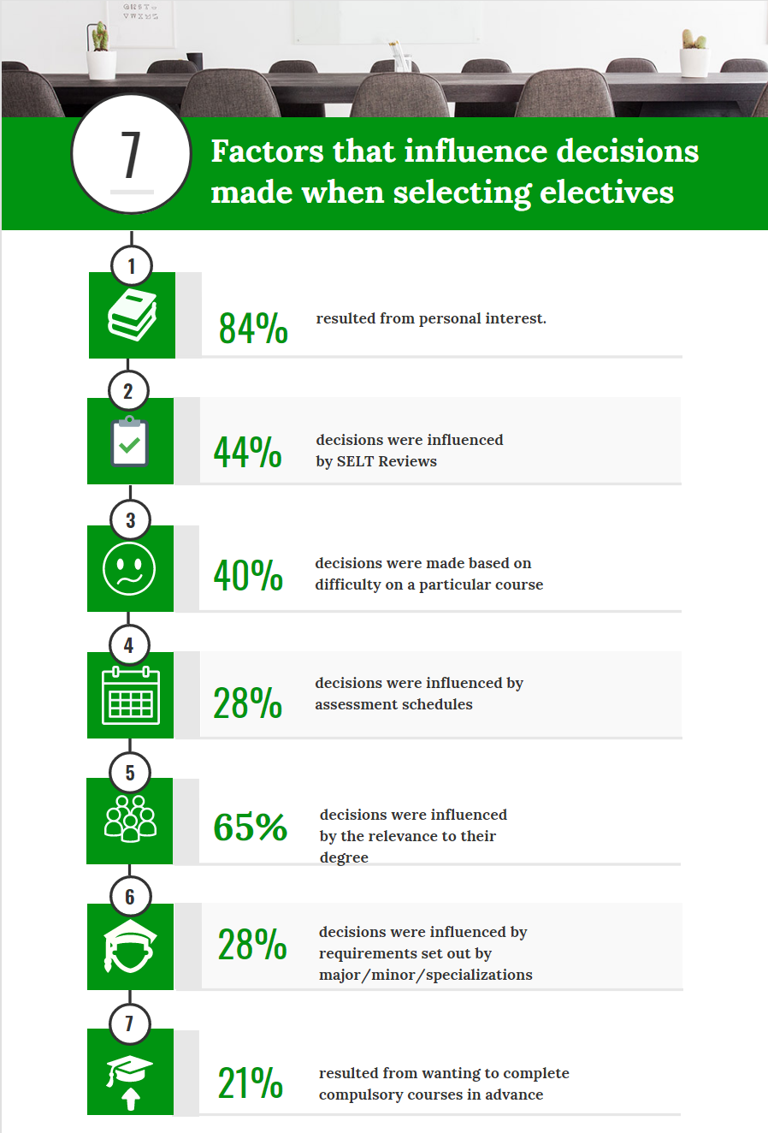

Slide 9

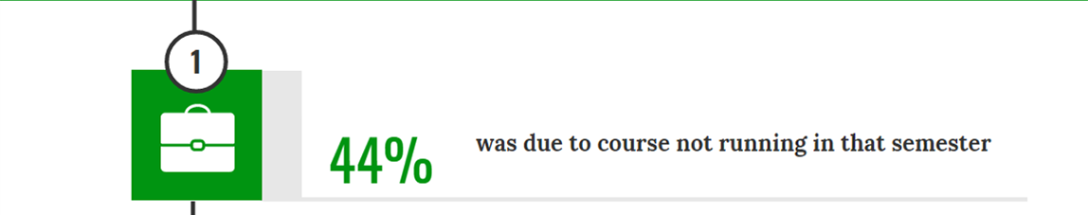
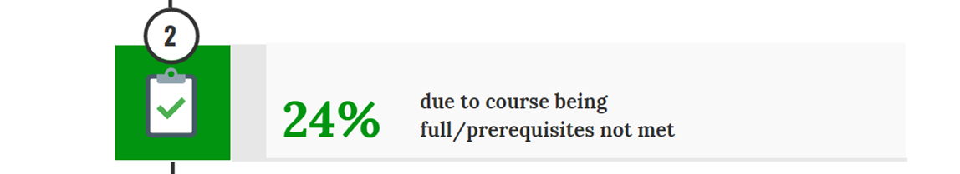
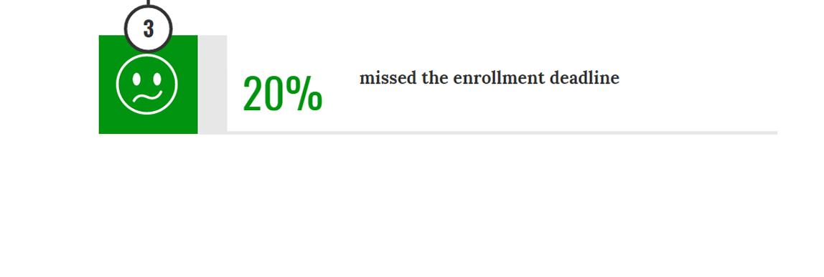

Slide 10

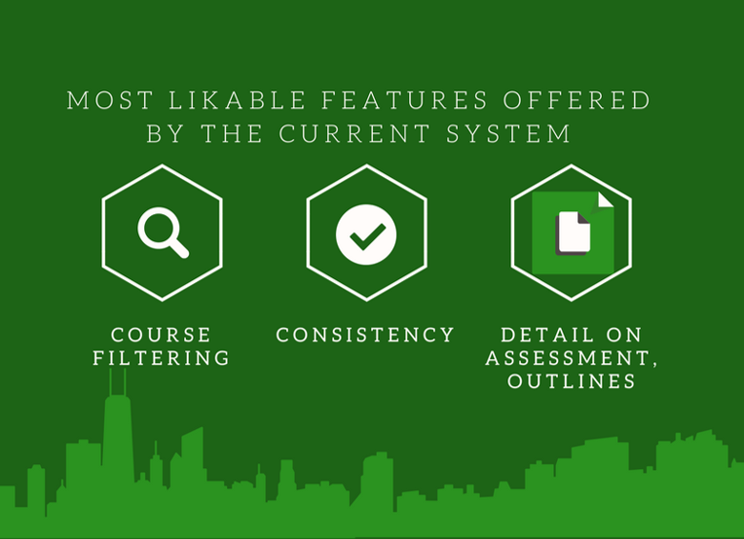



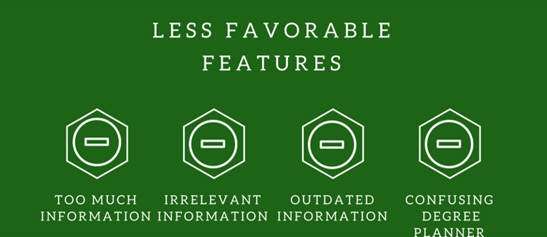


Slide 11
Planned Features
Intelligent Course Recommendation based on
Personal interests
Relevance to degree
AI Enhanced Search for
Courses by area, title, description, level
Simple program and course questions
Stretch goals
Interactive Degree Planner
Course Recommendation by
SELT Reviews
Opportunity for majors/minors/specialisations

Slide 12
Intelligent Search
Live Demo

Slide 13
Question and Answer
Enhanced Programs and Courses Search
Concept Awareness

Slide 14






AI Architecture
TF–IDF Transform
Programs and Courses Data
Wikipedia-enhanced Course Ontology
Wikipedia Data
Alexa Integration
Lucene Connector
Elastic Search
Intelligent Search

Slide 15
Next Steps
Prototype planned features
Improve with client feedback, implement stretch features
Evaluate user experience and performance
Implement required improvements

Slide 16
AI Course Selection

